Slide 1
Robodog

Slide 2
Understanding Self-Awareness and the Limitations of Artificial Intelligence (AI) in the Journey to Artificial General Intelligence (AGI)

Slide 3
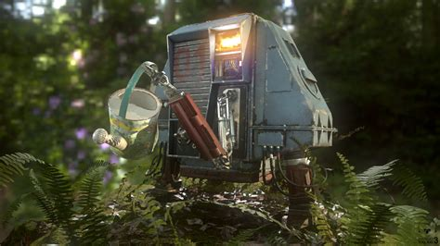
Machine Learning vs Artificial Intelligence (AI) vs Artificial General Intelligence (AGI)
Machine Learning (ML) is a subset of AI that focuses on a specific task. It involves training models on data and then using these models to make predictions or decisions without being explicitly programmed to perform the task.
Artificial Intelligence (AI) is a broader concept referring to machines or software that can mimic human intelligence. AI can learn from experience, adjust to new inputs, and perform tasks that usually require human intelligence.
Artificial General Intelligence (AGI) is a highly autonomous system that outperforms humans in most economically valuable work. It's about machines having the ability to understand, learn, adapt, and implement knowledge in a broad range of tasks at a level equal to or beyond human capabilities.

Slide 4
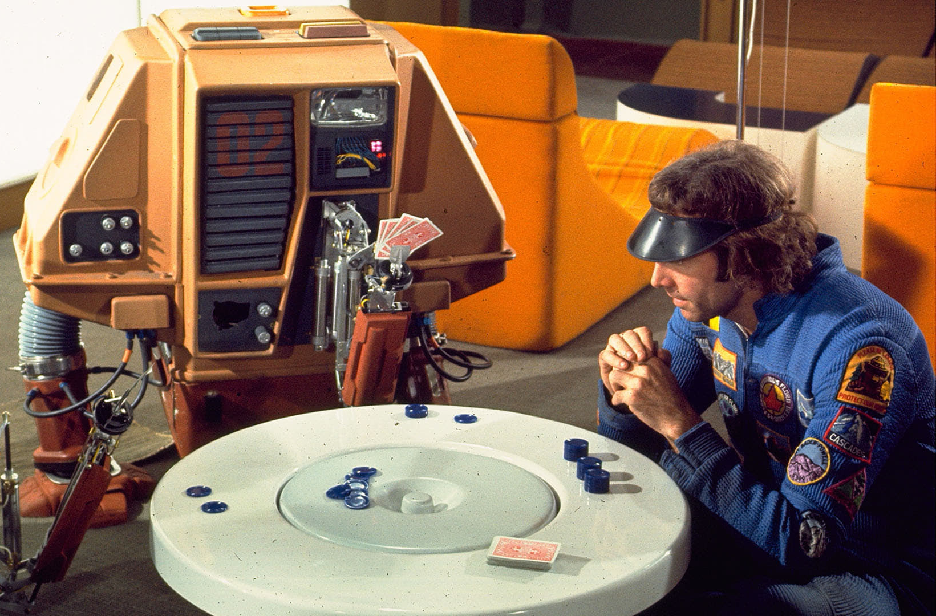
Large Language Model (LLM)
A Large Language Model (LLM) fits within the realm of Machine Learning and AI.
LLMs are trained using machine learning techniques, specifically a type called deep learning. They learn from large amounts of text data and build a statistical model that can generate human-like text.
Given that LLMs can generate responses or create content that mimics human-like text, they serve as an example of AI. They simulate a form of human intelligence, in this case, understanding and generating language.
While LLMs are impressive examples of AI, they do not fall under AGI.

Slide 5
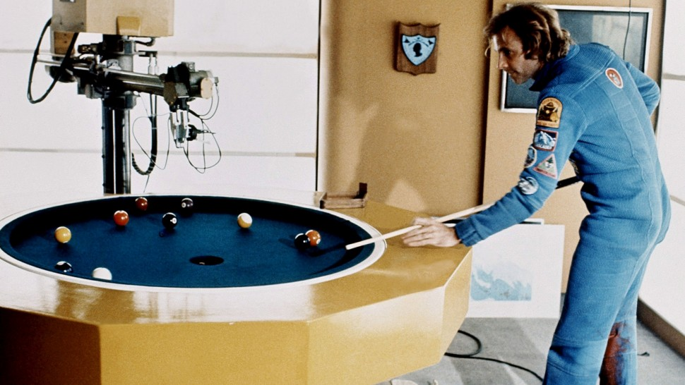
Limitations of Large Language Models
Language models like GPT can generate human-like text but don't truly understand the content.
These models are heavily dependent on the quality and nature of the input data.
Unlike humans, these models don't have self-awareness or consciousness.

Slide 6
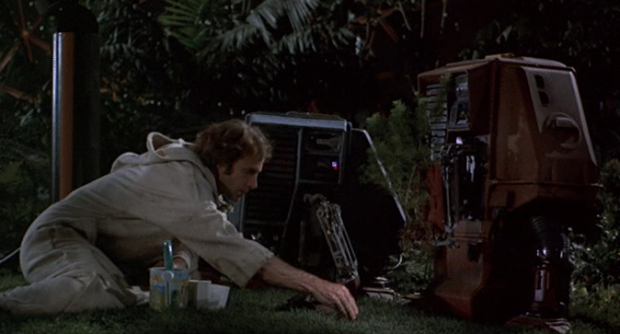
Theories of Self-Awareness
The theory of mind suggests that self-awareness stems from our ability to comprehend that others have different experiences and thoughts. This theory could map to AGI only.
The protagonist theory proposes that we see ourselves as the central character in our life's narrative, which leads to self-awareness. This theory could map to AI and AGI.
The emergent self-theory implies that self-awareness evolves from our interactions and relationships with others. This theory could be associated with AGI.
The mirror test theory posits that self-awareness can be measured by an entity's ability to recognise itself in a mirror. This theory could fit between AI and AGI.

Slide 7
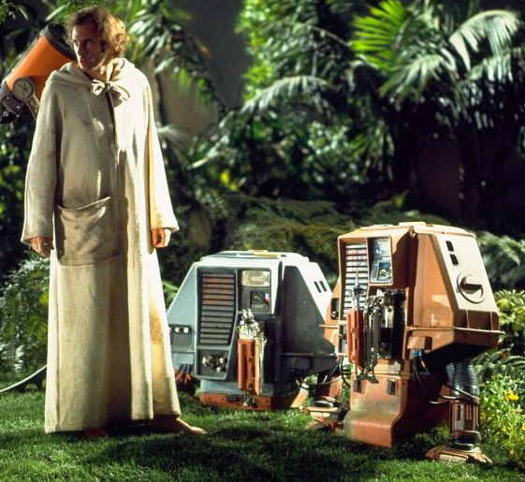
In the theory of mind, the AGI should be programmed to understand and predict the actions and thoughts of other agents (including humans and other AGI systems). In the protagonist theory, the AI or AGI needs to perceive itself as the central character in its experiences. In the emergent self-theory, the AGI might develop self-awareness through interactions and relationships with other entities. In the mirror test theory, the AGI system needs to recognize itself and distinguish its actions and state from those of others.
To make the transition from ML/AI to AGI, self-awareness is a crucial aspect.

Slide 8
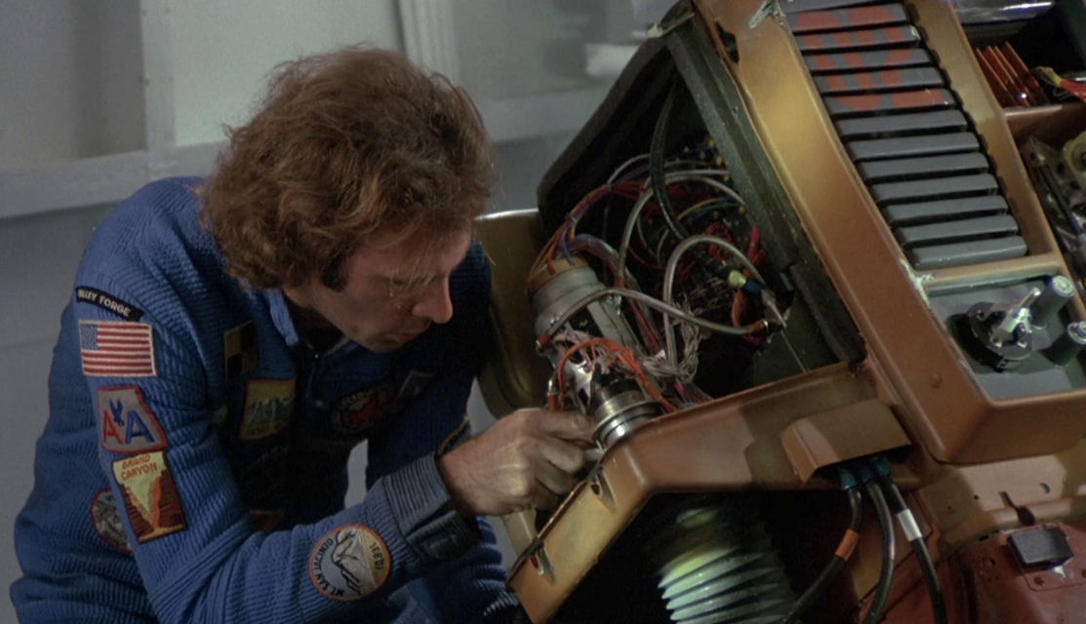
Path to Artificial General Intelligence (AGI)
Incremental Improvements: Continuous enhancements in AI models and techniques.
Interdisciplinary Research: Combining insights from psychology, neuroscience, and computer science.
Ethical Guidelines: Establishing guidelines to ensure the responsible development and use of AGI.

Slide 9
Path to Artificial General Intelligence (AGI)
Level | Type | Description
1 | Chatbots | AI with natural conversation language abilities
2 | Reasoners | AIs with human-levels of problem-solving across a broad range of topics
3 | Agents | AI entities capable of autonomously making decisions and carrying out tasks either independently or based on human guidance.
4 | Innovators | AI that can aid in the invention of new ideas and contribute to human knowledge
5 | Organizations | AI that is capable of doing all of the work of an organization independently

Slide 10
Robodog
A comprehensive and portable tool designed to tokenize knowledge artefacts and interact with large language models (LLMs)

Slide 11
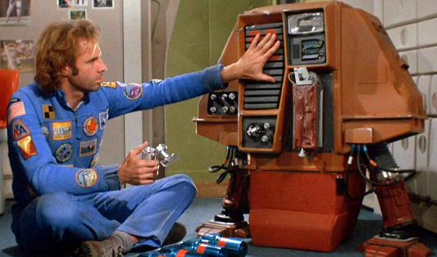
Why Create Robodog
A pre-trained transformer-based model is trained on the Internet and third-party providers license data.
These models are useful curiosities. They are not perfect, but they can help us.
Given that AGI seems far away, we must make the most of what we have now.
To do this, we must get out own knowledge into the models.
There are limitations and we must be careful.

Slide 12
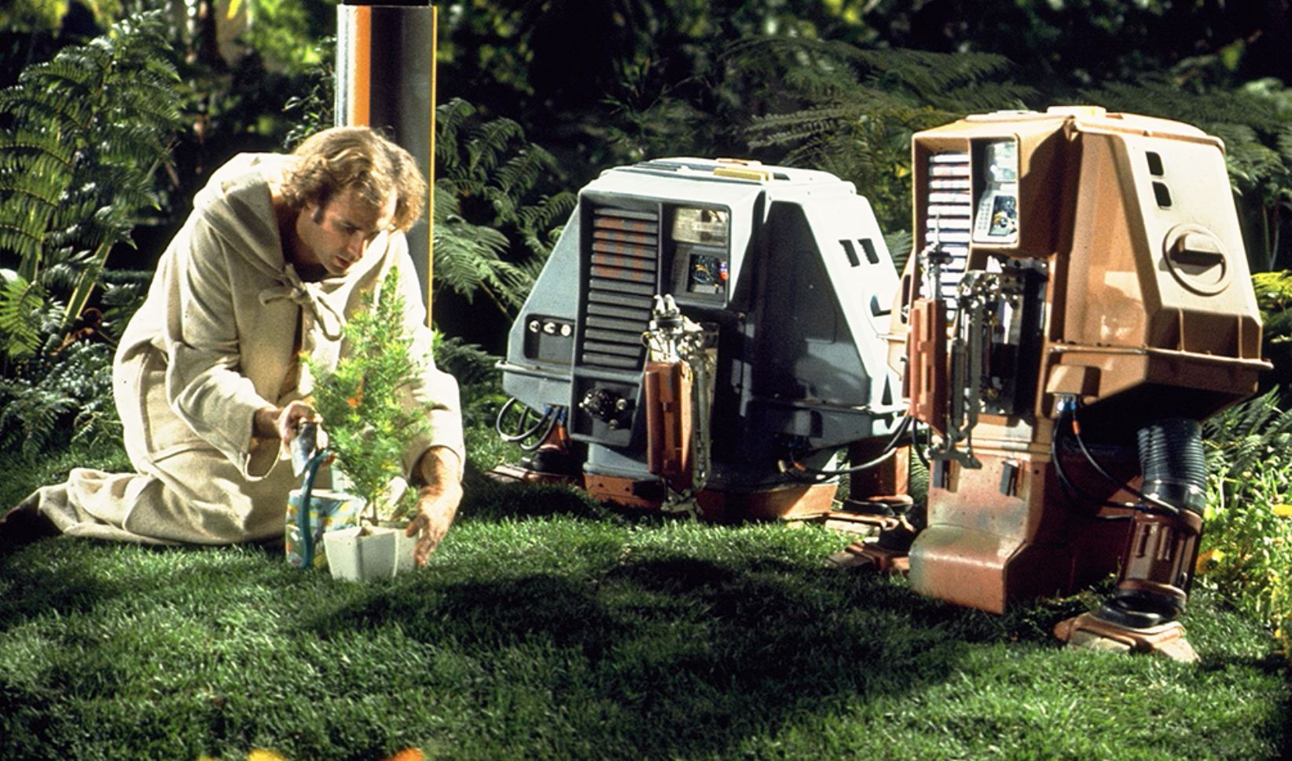
Knowledge Artifacts
Our personal knowledge artefacts are fragmented into many formats.
They are embedded into many providers: Google, Microsoft, Dropbox, Adobe, Apple
They exist in a myriad of formats, from images and PDFs to text, email, tasks, digital devices, and notes.
With Robodog, we can traverse our artefacts and convert them into a format in which a model can interact with the transformer model.

Slide 13
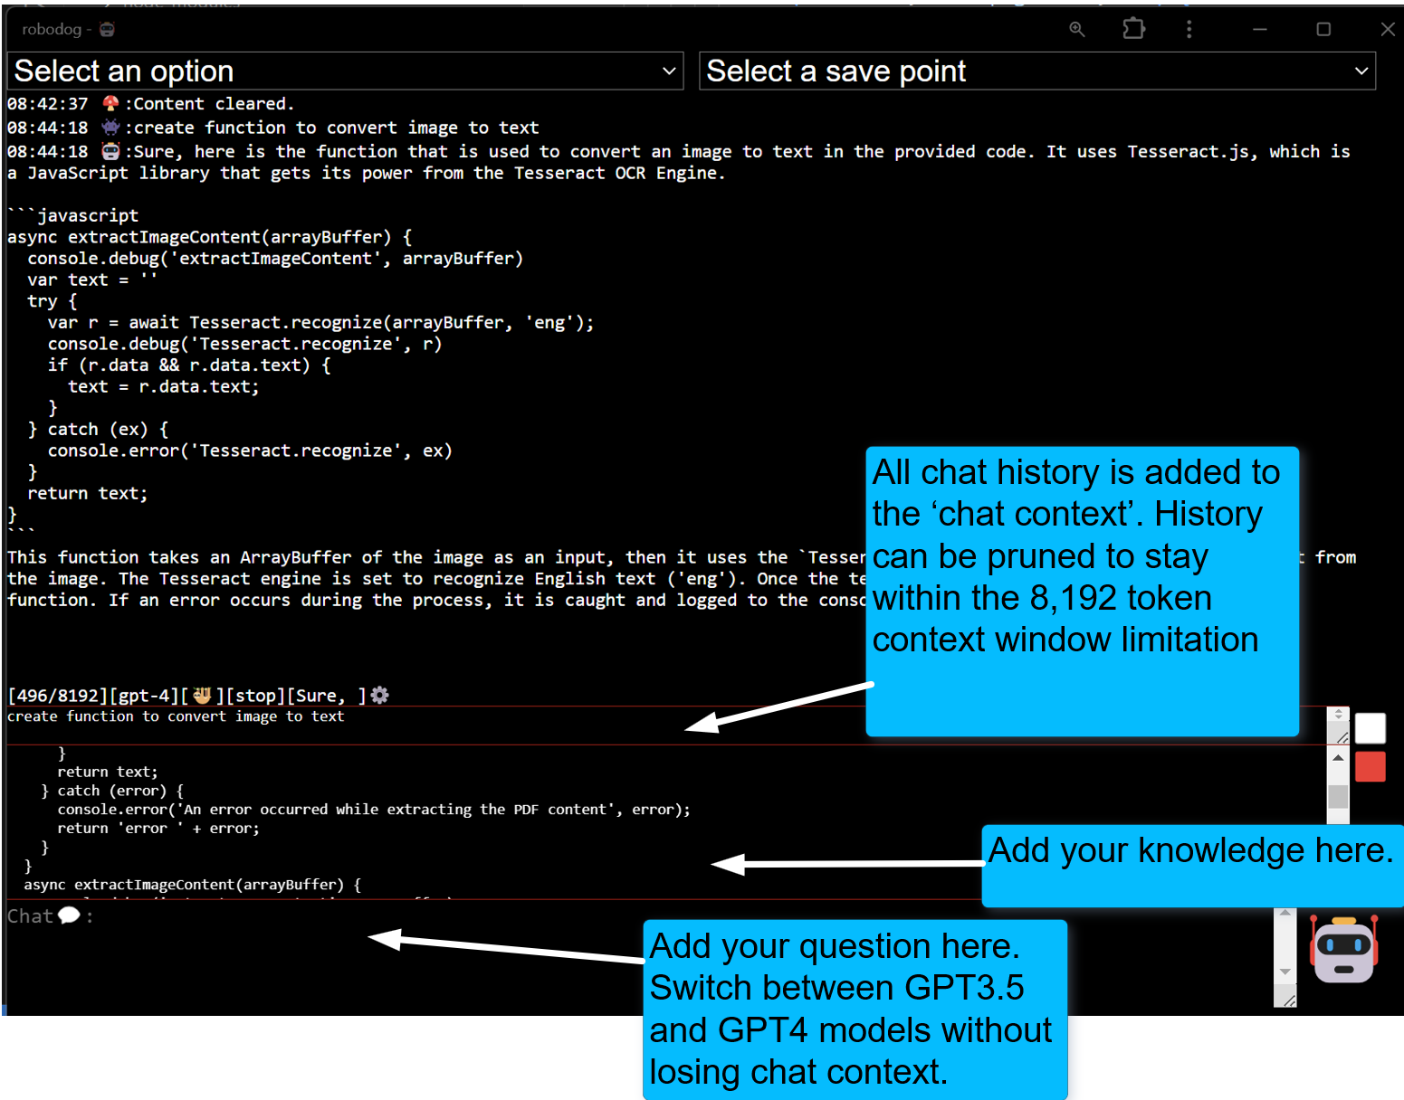
How Robodog Works

Slide 14
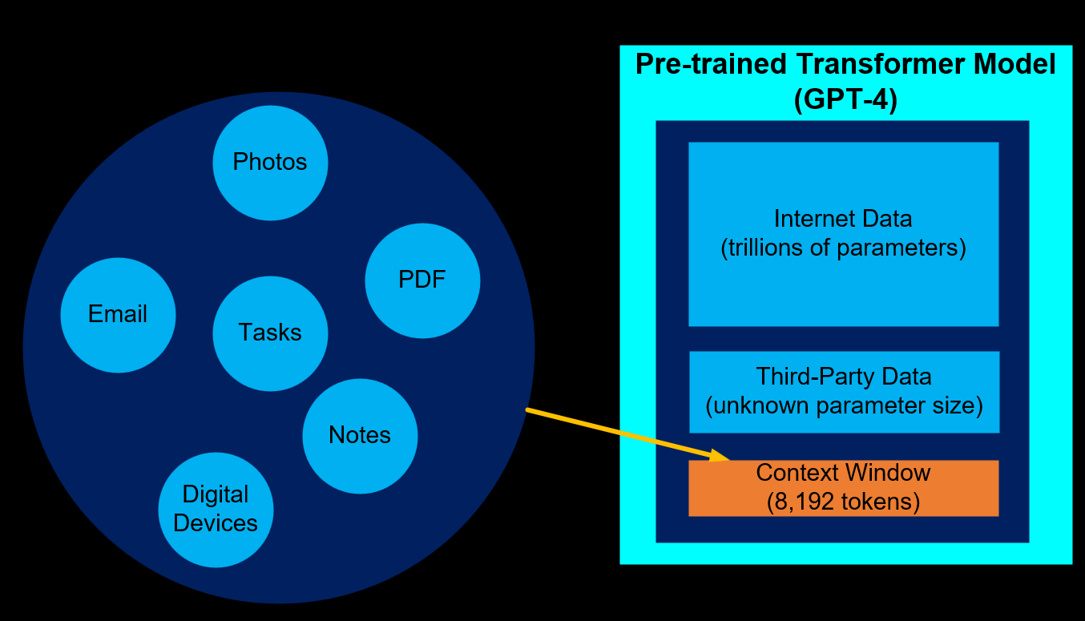
Knowledge Artifacts vs Context Window
There is no way around the limitations of the context window size.
Less expensive models are 4,000 tokens and more expensive models are 128,000 tokens
There is a need to prune the context window
The open ai custom GPT product attempts to automate pruning process using an elastic search. From experience, this does not work very well in practice

Slide 15
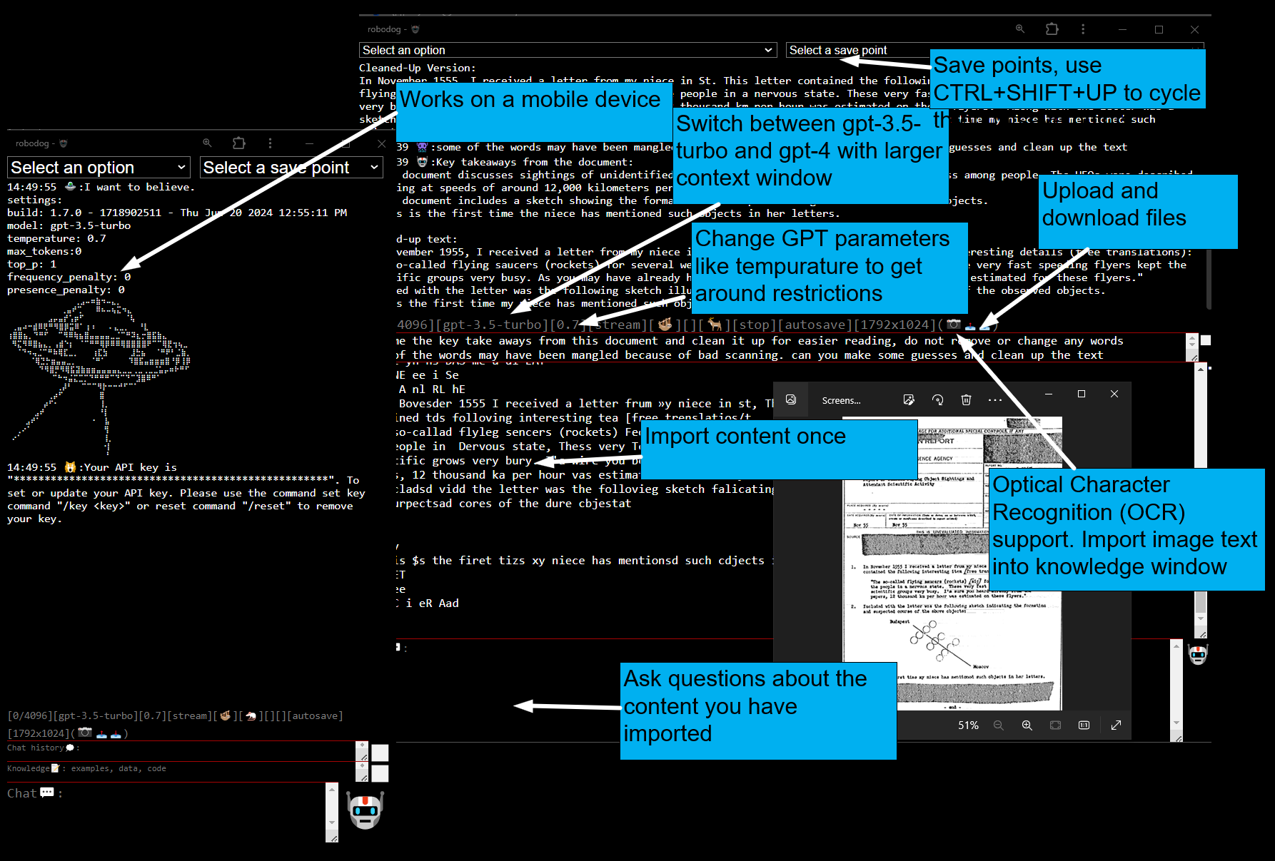
Robodog Features

Slide 16
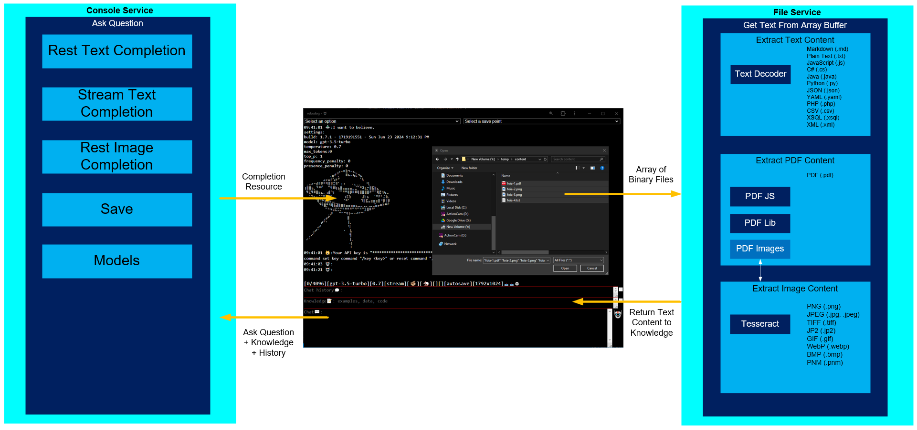
Separation of Concerns

Slide 17
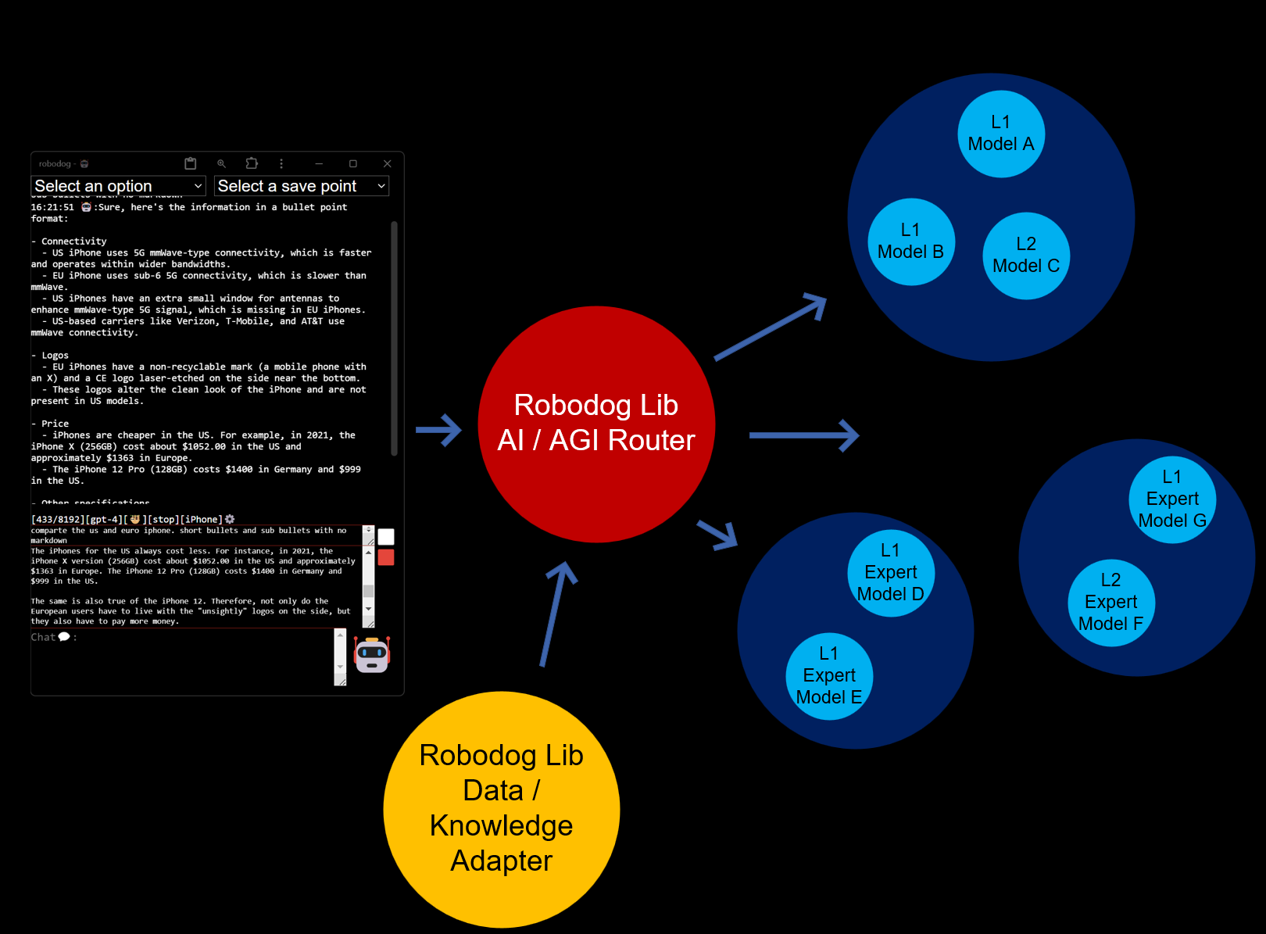
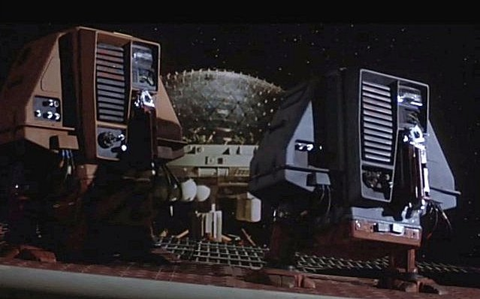
Robodog Roadmap

Slide 18
Conclusion

Slide 19
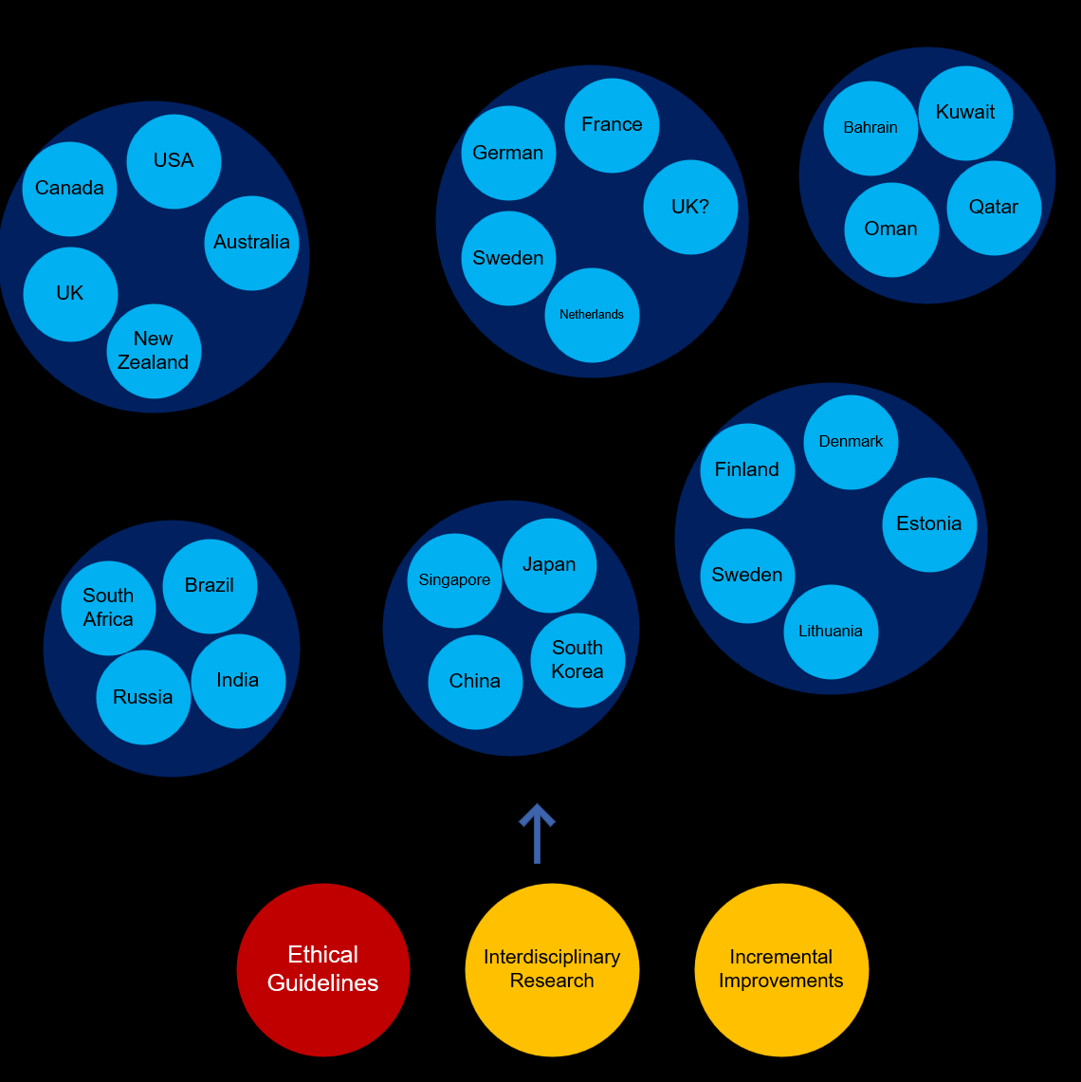
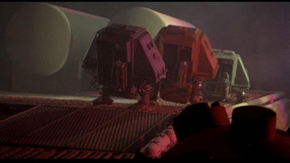
AI / AGI / NHI Cold War

